Slide 1
Electronic Devices
Mid Term Lecture - 02
Reference book:
Electronic Devices and Circuit Theory
Robert L. Boylestad and L. Nashelsky , (11th Edition)

Slide 2
Electronic Devices
CHAPTER 1 SEMICONDUCTOR DIODES

Slide 3
Semiconductor Diode: No Applied Bias (V=0 V)
Now that both n – and p -type materials are available, we can construct our first solid-state electronic device: The semiconductor diode , with applications too numerous to mention, is created by simply joining an n -type and a p -type material together.
In the absence of an applied bias across a semiconductor diode, the net flow of charge in one direction is zero.

Slide 4
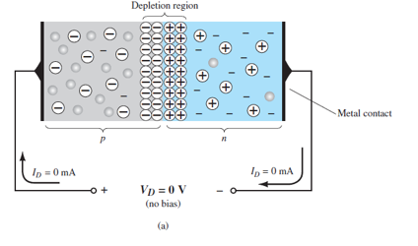
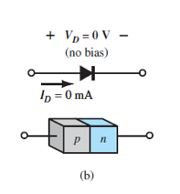
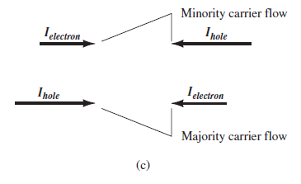

No Applied Bias (VD=0 V)

Slide 5
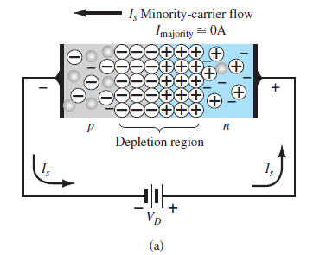
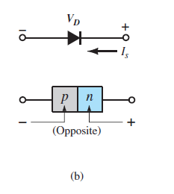

Reverse-Bias Condition (VD<0 V)
The current that exists under reverse-bias conditions is called the reverse saturation current and is represented by I_{s} .

Slide 6
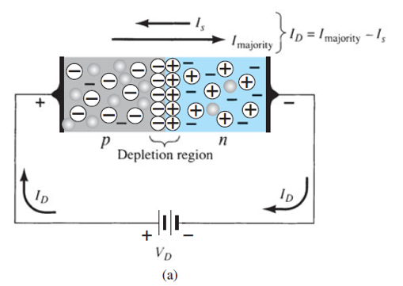
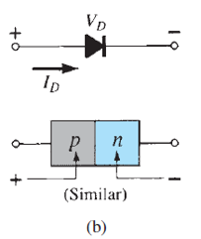

Forward-Bias Condition (VD>0 V)
A forward-bias or “on” condition is established by applying the positive potential to the p -type material and the negative potential to the n -type material as shown in Fig. 1.14 .

Slide 7

Forward-Bias Condition (VD>0 V) Contd.
It can be demonstrated through the use of solid-state physics that the general characteristics of a semiconductor diode can be defined by the following equation, referred to as Shockley’s equation, for the forward- and reverse-bias regions:
Where, I_{s} is the reverse saturation current
V_{D} is the applied forward-bias voltage across the diode
n is an ideality factor, which is a function of the operating conditions and physical construction; it has a range between 1 and 2 depending on a wide variety of factors (n = 1 will be assumed throughout this text unless otherwise noted).

Slide 8

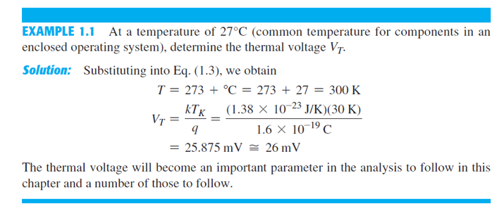
Forward-Bias Condition (VD>0 V) Contd.
The voltage V_{T} in Eq. (1.1) is called the thermal voltage and is determined by:
where k is Boltzmann’s constant = 1.38 * 10⁻²³ J/K
T_{K} is the absolute temperature in kelvins = 273 + the temperature in °C
q is the magnitude of electronic charge = 1.6 * 10⁻¹⁹ C

Slide 9
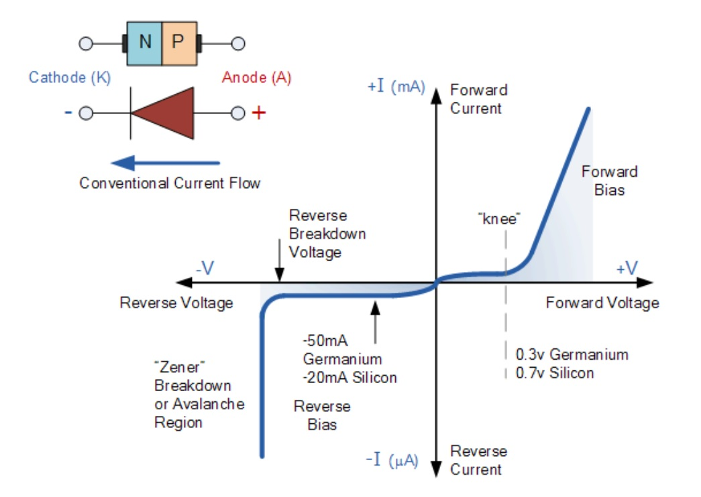
Semiconductor Diode Characteristics

Slide 10
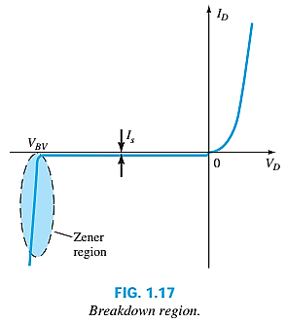
Breakdown Region
The maximum reverse-bias potential that can be applied before entering the breakdown region is called the peak inverse voltage (referred to simply as the PIV rating) or the peak reverse voltage (denoted the PRV rating).
In general, the breakdown voltage of GaAs diodes is about 10% higher those for silicon diodes but after 200% higher than levels for Ge diodes.

Slide 11
Breakdown Region Contd.
As the voltage across the diode increases in the reverse-bias region, the velocity of the minority carriers responsible for the reverse saturation current Is will also increase.
Eventually, their velocity will be sufficient to release additional carriers through collisions with otherwise stable atomic structures.
These additional carriers can then aid to establish a high avalanche current and the avalanche breakdown region determined.

Slide 12
Breakdown Region Contd.
The avalanche region (V_{BV}) can be brought closer to the vertical axis by increasing the doping levels in the p- and n-type materials.
However, as V_{BV} decreases to very low levels, such as -5 V, another mechanism, called Zener breakdown, will contribute to the sharp change in the characteristic.
It occurs because there is a strong electric field in the region of the junction that can disrupt the bonding forces within the atom and “generate” carriers.
This change in the characteristic at any level is called the Zener region.

Slide 13
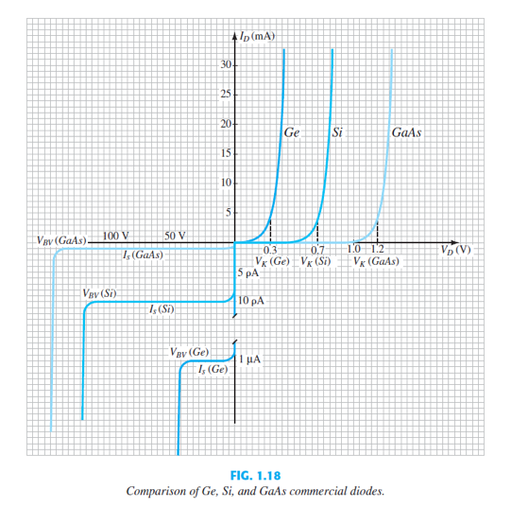
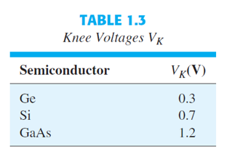
Ge, Si & GaAs

Slide 14
Temperature Effects
In the forward-bias region the characteristics of a silicon diode shift to the left at a rate of 2.5 mV per centigrade degree increase in temperature.
In the reverse-bias region the reverse current of a silicon diode doubles for every 10°C rise in temperature.
The reverse breakdown voltage of a semiconductor diode will increase or decrease with temperature.
As temperature increases it adds energy to the diode:
It reduces the required forward bias voltage for forward bias conduction.
It increases the amount of reverse current in the reverse bias condition.
It increases maximum reverse bias avalanche voltage.
Germanium diodes are more sensitive to temperature variations than silicon or gallium arsenide diodes.

Slide 15
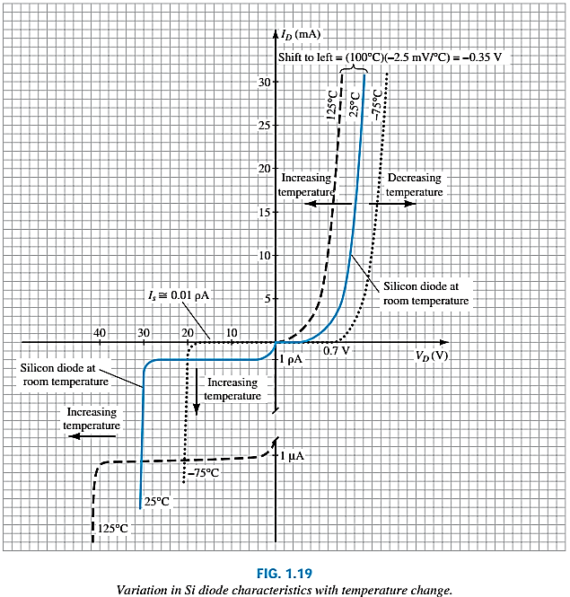
Temperature Effect Contd.
In the forward-bias region the characteristics of a silicon diode shift to the left at a rate of 2.5 mV per centigrade degree increase in temperature.
In the reverse-bias region the reverse current of a silicon diode doubles for every 10°C rise in temperature.
Finally, The reverse breakdown voltage of a semiconductor diode will increase or decrease with temperature.

Slide 16
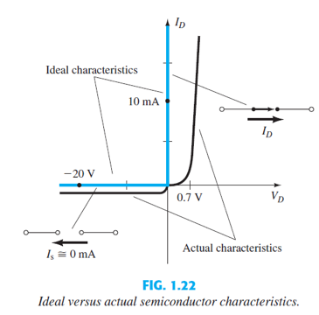
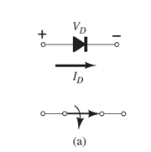
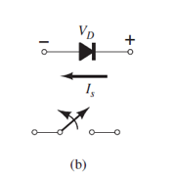

Ideal vs Practical
Ideally, in the forward-bias region, the resistance of the diode should be 0 Ω.
In the reverse-bias region its resistance should be ∞ Ω to represent the open-circuit equivalent.

Slide 17
Resistance Levels
There are three types of diode resistance:
DC (static) resistance
AC (dynamic) resistance
Average AC resistance

Slide 18
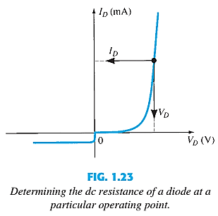

DC or Static Resistance
For a specific applied DC voltage V_{D,} the diode has a specific current I_{D}, and a specific resistance R_{D}.
In general, therefore, the higher the current through a diode, the lower is the dc resistance level.

Slide 19
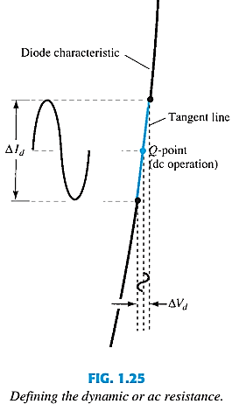
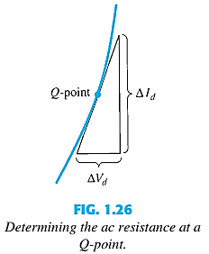
AC or Dynamic Resistance
The designation Q-point is derived from the word quiescent, which means “still or unvarying.”
In general, therefore, the lower the Q-point of operation (smaller current or lower voltage), the higher is the ac resistance.

Slide 20


AC or Dynamic Resistance Contd.
In the forward bias region:
The resistance depends on the amount of current (I_{D}) in the diode.
The voltage across the diode is fairly constant (26 mV for 25°C).
r_{B} ranges from a typical 0.1 Ω for high power devices to 2 Ω for low power, general purpose diodes. In some cases r_{B} can be ignored.
In the reverse bias region:

Slide 21
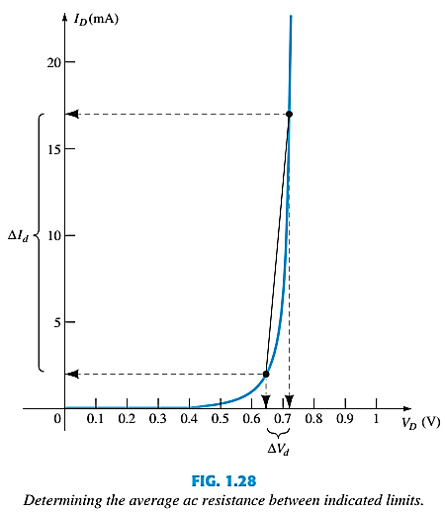

Average AC Resistance
The average ac resistance is, by definition, the resistance determined by a straight line drawn between the two intersections established by the maximum and minimum values of input voltage.

Slide 22
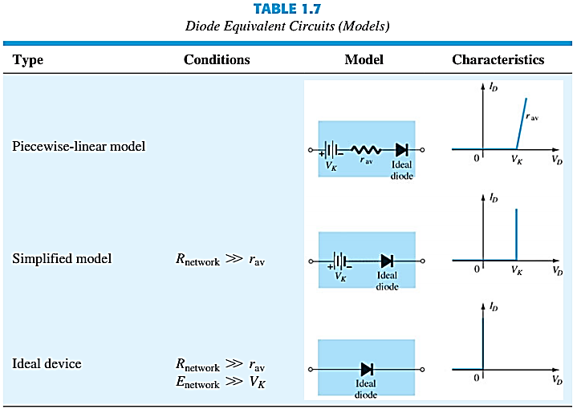
Diode Equivalent Circuits
An equivalent circuit is a combination of elements properly chosen to best represent the actual terminal characteristics of a device or system in a particular operating region.

Slide 23
Thank You

